Slide 1
Databricks Certified Generative AI Engineer Associate Module 2025
EXL

Slide 2
Definition:
The Databricks Certified Generative AI Engineer Associate certification exam assesses an individual’s ability to design and implement LLM-enabled solutions using Databricks. This includes problem decomposition to break down complex requirements into manageable tasks as well as choosing appropriate models, tools, and approaches from the current generative AI landscape for developing comprehensive solutions.
It also assesses Databricks-specific tools such as
Vector Search for semantic similarity searches,
Model Serving for deploying models and solutions,
MLflow for managing solution lifecycle, and
Unity Catalog for data governance.
These questions are segmented into six Pillars and 45 sub-segments:
Design Applications — 14%
Data Preparation — 14%
Application Development — 30%
Assembling and Deploying Apps — 22%
Governance — 8%
Evaluation and Monitoring — 12%

Slide 3
Section 1: Design Applications
EXL

Slide 4
Section 1: Design Applications
1. Design a prompt that elicits a specifically formatted response
Tips for Effective Prompt Engineering
Model-Specific Prompts
Iterative Development
Avoiding Bias and Hallucinations: Include instructions to avoid generating false information. Example: “Do not make things up if you do not know. Say ‘I do not have that information’.”
Use Delimiters: Use delimiters to distinguish between instruction and context, such as ###, `````, {}, `[]`, or `
Structured Output: “Return the movie name mentioned in the form of a JSON object. The output should look like {‘Title’: ‘In and Out’}.”
Examples of Advanced Prompting Techniques
Zero-shot Prompting — Without examples
Few-shot Prompting — Fancy word for more than 1 example in a prompt.
Prompt Chaining — Chain of prompts

Slide 5
Key Elements of a Good Prompt:
Clear Instruction: Provide a clear directive specifying what the model should do.
Contextual Information: Include background or additional information that helps the model understand the task.
Input / Question: Specify the query or data the model needs to process.
Output Type / Format: Define the desired structure or style of the response.
2. Select model tasks to accomplish a given business requirement
Key Steps in Selecting Model Tasks
Identify Business Objectives
Decompose the Problem: Break down the overall objective into smaller, manageable tasks. Example: For improving customer service, tasks might include sentiment analysis, FAQ retrieval, and automated response generation.
Task Mapping: Match the business objectives to specific AI model tasks; you could use multiple LLM for specilized tasks
Select Appropriate Models: MPT VS Chatgpt VS Lamma VS BERT or RoBERTa Vs other models; Which all models are open source? Text generation model vs other kinds of model.

Slide 6
Consider the Interaction Between Tasks: Sentiment analysis might be performed first, followed by retrieval of FAQs, and finally, response generation.
Utilize Tools and Frameworks: Using LangChain for creating multi-stage reasoning chains that handle complex workflows.
Evaluate, Optimize and Iterate: Continuously evaluate and optimize the models and tasks to ensure they meet the business requirements based on performance, accuracy, and context applicability. Example: Regularly updating the training data and fine-tuning models to improve performance.
3. Select chain components for a desired model input and output
Frameworks and Libraries for Building Chains
LangChain, 2. LLamaIndex, 3. OpenAI Agents
Components:
Chain: An ordered sequence of components that processes information step-by-step for a specific AI task.
Prompt: The text input or instruction designed to guide an AI model's response.
Retriever: A component that fetches relevant documents or information from a source to support the AI's output.
Tool or ChatGPT Function Calling: Mechanisms that allow the AI to interact with external functions, APIs, or tools for additional capabilities.
LLM: A large language model that generates human-like text responses based on given input.

Slide 7
Integration and Implementation
1. Framework Integration: Use LangChain to build and manage the chain components. Integrate with databases and external APIs for dynamic data retrieval and interaction.
2. Logging and Monitoring: Use MLflow to log the performance of each component in the chain. Monitor the entire workflow to ensure high performance and accuracy.
3. Optimization: Continuously evaluate the chain’s performance and make necessary adjustments. Update models and retrain as needed to maintain accuracy and relevance.
4. Translate business use case goals into a description of the desired inputs and outputs for the AI pipeline
Implementation Considerations
Data Quality
Model Selection: Choose models that are well-suited for each task — accuracy VS speed VS cost VS open source VS regulations VS hosting cost VS performance — relevance to the business goals.
Integration of all components
Testing and Optimization
5. Define and order tools that gather knowledge or take actions for multi-stage reasoning

Slide 8
Patterns for Agent Reasoning:
ReAct (Reason + Act):
Thought or Reason: Reflect on the problem given and previous actions taken.
Act: Choose the correct tool and input format to use.
Observe (Continues to Reason): Evaluate the result of the action and generate the next thought.
2. Tool Use / Function Calling: Agents interact with external tools and APIs to perform specific tasks.
Example Tools:
Research / Search Tools: Web browsing, search engines, Wikipedia.
Document Retrieval: Database retriever, vector DB retriever, document loader.
Image Processing: Image generation, object detection, image classification.
Coding: Code execution, documentation generator, debugging/testing .

Slide 9
3. Planning: Agents must dynamically adjust their goals and plans based on changing conditions.
Tasks:
Single Task: A straightforward task with a single goal.
Sequential Task: Tasks that need to be performed in a specific order.
Graph Task: Complex tasks that involve multiple interdependent actions.
4. Multi-Agent Collaboration: Multiple agents work collaboratively, each handling different aspects of a complex task.
Benefits: Allows modularization and specialization.

Slide 10
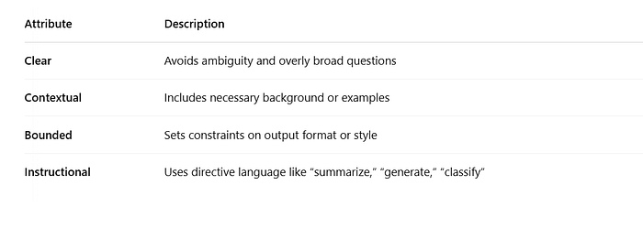
Anatomy of an Effective Prompt
A high-quality prompt is:
Example:
“You are a helpful assistant trained to summarize insurance policy documents. Summarize the key coverage conditions in 3 bullet points using non-technical language.”
This sets:
The role (a helpful assistant)
The task (summarization)
The format (3 bullet points)
The style (non-technical)

Slide 11
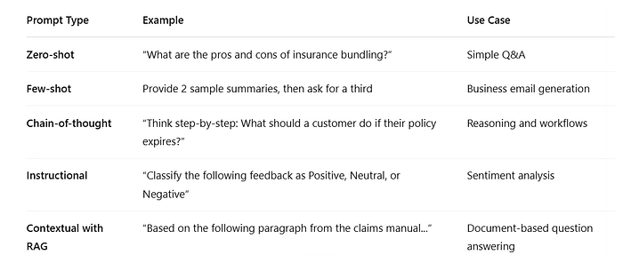
Prompt Types in Enterprise Applications

Slide 12
Prompt Engineering on Databricks
Databricks provides two core frameworks for working with prompts:
LangChain
Mosaic AI Prompt Playground
from langchain.prompts import PromptTemplate prompt_template = PromptTemplate( input_variables=["product", "features"], template="Generate a concise product summary for {product} highlighting: {features}." ) prompt = prompt_template.format(product="Auto Insurance", features="accident forgiveness, roadside assistance")
LangChain Example
Create chains of prompts and responses to execute multi-step AI workflows.

Slide 13
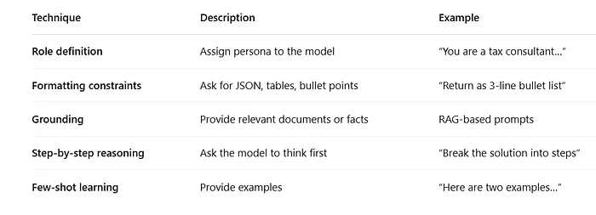
Mosaic AI Prompt Playground
Mosaic AI lets you:
Experiment with prompts in a UI
Compare model responses across providers (DBRX, GPT-4, MPT)
Save and productionize prompts into chains or agents
Evaluate hallucination, tone, style consistency
Techniques to Improve Prompt Performance

Slide 14
Key Evaluation Metrics:
Relevance: Is the response on-topic?
Factuality: Are the facts accurate?
Completeness: Are all user queries addressed?
Style: Does it match tone and format expectations?
Sample Business Scenario:
You want to create a Gen AI assistant that answers customer queries about health insurance.
Bad Prompt:
“Explain health insurance.”
Good Prompt:
“You are an expert health insurance agent. A customer has asked: ‘What is the difference between co-pay and deductible?’ Provide a concise answer using customer-friendly language and examples.”
Real-World Example: Customer Support Assistant
Goal: Build a prompt for a RAG-powered assistant to explain insurance clauses to a customer.

Slide 15
Real-World Example: Customer Support Assistant
Goal: Build a prompt for a RAG-powered assistant to explain insurance clauses to a customer.
prompt = f""" You are a support assistant for a health insurance company. Use the context below to answer the user's question in a friendly, accurate manner. Context: {retrieved_doc_chunks} Question: {user_question} Answer: """

Slide 16
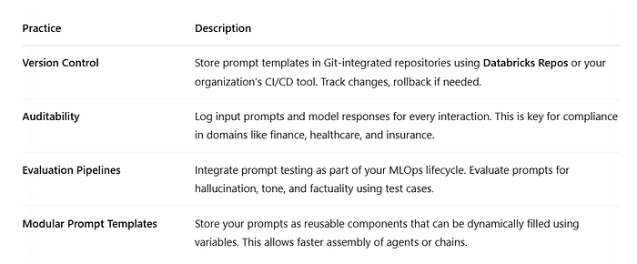
Governance of Prompts in Enterprise Settings
In production environments, prompt engineering isn’t just about writing better prompts — it’s about managing them at scale with consistency, traceability, and accountability.
Key Governance Practices:

Slide 17
Prompt Repository (A Must-Have)
A Prompt Repository is a central location — often a Git-backed folder structure or a managed catalog — where all prompt templates are stored, versioned, and governed.
Benefits of a Prompt Repository:
Centralized prompt governance
Role-based access for sensitive prompts
Easier experimentation through branches or forks
Collaboration between engineering, product, and compliance teams
In Databricks, you can integrate this with:
MLflow to track usage per model version
LangChain to load templates dynamically
Databricks Unity Catalog for access controls

Slide 18
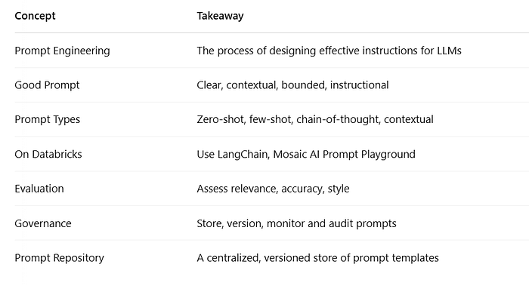
Summary

Slide 19
Section 2: Data Preparation
EXL

Slide 20
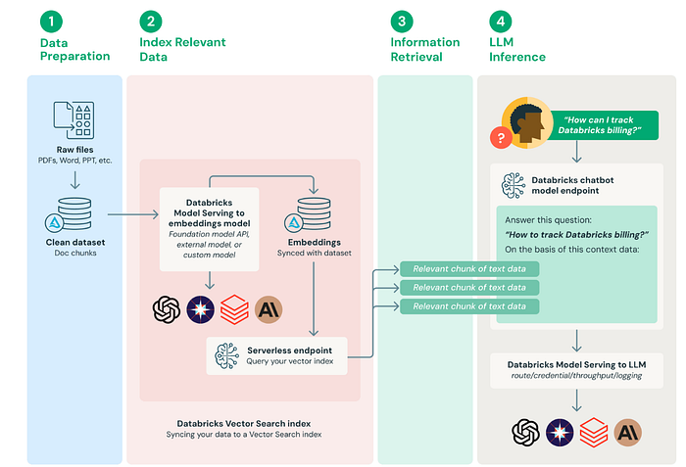
Understanding Retrieval-Augmented Generation (RAG)
Generative AI models, especially large language models (LLMs) like DBRX, GPT-4, or MPT, are trained on vast amounts of public data. They possess strong language understanding and generation capabilities. However, they are inherently static and general-purpose, meaning:
They don’t know your proprietary enterprise data (internal manuals, client documents, support tickets).
They can’t update themselves with real-time knowledge.
They sometimes hallucinate, i.e., generate convincing but incorrect responses.
This is where Retrieval-Augmented Generation (RAG) enters the picture.
The flow illustrates four main stages: data preparation, indexing data as embeddings, information retrieval, and LLM-based inference based on retrieved chunks.​
This structure is for RAG systems, combining vector search over document chunks and large language model generation for context-aware Q&A.

Slide 21
Understanding Retrieval-Augmented Generation (RAG)
Data Preparation: Raw files (PDFs, Word, PPTs, etc.) are cleaned and split into smaller document chunks for processing.​
Index Relevant Data: Each document chunk is transformed into a vector (embedding) using specialized models and stored in a vector database, making it searchable based on meaning rather than exact words.
Information Retrieval: The system quickly finds and returns the most relevant chunks of data in response to user queries.​
LLM Inference: The retrieved relevant chunks and user question are sent to a language model, which uses this context to generate a clear, accurate natural language answer.

Slide 22
What is Retrieval-Augmented Generation (RAG)?
RAG is an architecture that combines two powerful capabilities:
Retrieval: Pulling relevant context from external data sources, typically using vector search over embedded documents.
Generation: Using the retrieved context along with a user question to generate a natural language response via an LLM.
Formal Definition:
Retrieval-Augmented Generation is a hybrid approach where a language model is provided with dynamically retrieved, contextually relevant documents to improve its factual accuracy, reduce hallucinations, and adapt to private or recent knowledge.
Unlike fine-tuning, which involves retraining the model on new data (costly and slow), RAG dynamically injects real-world knowledge into the model’s responses at inference time.

Slide 23
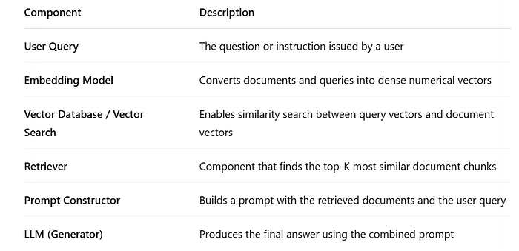
Core Components of a Retrieval-Augmented Generation (RAG)

Slide 24
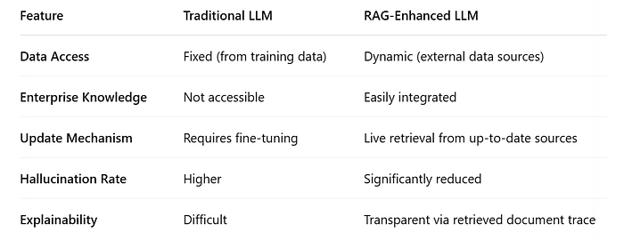
Traditional LLM vs RAG Architecture

Slide 25
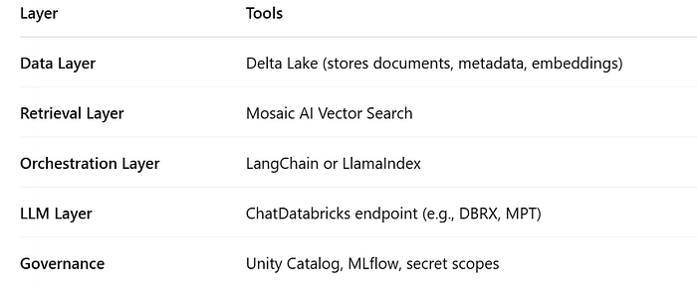
How RAG Works on Databricks?
Databricks provides all the building blocks for constructing a scalable RAG system:

Slide 26
1. A retail company is building a question-answering bot using RAG. Sensitive customer data is stored alongside product documents. Which tool best helps ensure compliance with data governance during indexing and retrieval?
a) MLflow
b) Unity Catalog
c) Mosaic AI Vector Search
d) LangChain

Slide 27
1. A retail company is building a question-answering bot using RAG. Sensitive customer data is stored alongside product documents. Which tool best helps ensure compliance with data governance during indexing and retrieval?
a) MLflow
b) Unity Catalog
c) Mosaic AI Vector Search
d) LangChain
Reason - Unity Catalog enforces secure, centralized access control and auditability, essential for protecting sensitive data in RAG pipelines.

Slide 28
2. Your team uses Delta Lake for document and embedding storage and Mosaic AI Vector Search for fast queries. However, responses from the bot seem outdated after recent database updates. What is the most likely cause?
a) Outdated LLM weights
b) Old embeddings need re-generation
c) Secret scopes not refreshed
d) Serverless endpoint misconfigured

Slide 29
2. Your team uses Delta Lake for document and embedding storage and Mosaic AI Vector Search for fast queries. However, responses from the bot seem outdated after recent database updates. What is the most likely cause?
a) Outdated LLM weights
b) Old embeddings need re-generation
c) Secret scopes not refreshed
d) Serverless endpoint misconfigured
Reason - Old embeddings must be regenerated after database updates to ensure the retrieval search returns current and accurate information.

Slide 30
3. Consider a highly-regulated financial environment. Why would a RAG-enhanced LLM be more suitable than a traditional LLM for explainability in audit scenarios?
a) It guarantees zero hallucination
b) It disables use of enterprise knowledge
c) Training data is always up to date
d) Retrieval steps allow document traceability

Slide 31
3. Consider a highly-regulated financial environment. Why would a RAG-enhanced LLM be more suitable than a traditional LLM for explainability in audit scenarios?
a) It guarantees zero hallucination
b) It disables use of enterprise knowledge
c) Training data is always up to date
d) Retrieval steps allow document traceability
Reason - RAG-enhanced LLMs allow users to trace answers directly to retrieved documents, meeting high explainability demands for audits.

Slide 32
4. A user reports hallucinations in generated answers despite using a well-tuned LLM endpoint. Which RAG pipeline enhancement is most effective to lower hallucination rates for enterprise Q&A?
a) Use dynamic, live retrieval from enterprise sources
b) Rely on fixed training data
c) Add more metadata in Delta Lake
d) Increase orchestration steps

Slide 33
4. A user reports hallucinations in generated answers despite using a well-tuned LLM endpoint. Which RAG pipeline enhancement is most effective to lower hallucination rates for enterprise Q&A?
a) Use dynamic, live retrieval from enterprise sources
b) Rely on fixed training data
c) Add more metadata in Delta Lake
d) Increase orchestration steps
Reason - Live retrieval from dynamic enterprise sources ensures the model uses fresh, accurate data, thereby lowering hallucination rates.

Slide 34
5. Your organization must frequently update document knowledge without LLM retraining. Which combination provides the most scalable architecture?
a) Fine-tuning the LLM and Unity Catalog
b) Live embedding updates in Delta Lake + Mosaic AI Vector Search
c) Static embeddings + MLflow
d) Relying solely on orchestration layer changes

Slide 35
5. Your organization must frequently update document knowledge without LLM retraining. Which combination provides the most scalable architecture?
a) Fine-tuning the LLM and Unity Catalog
b) Live embedding updates in Delta Lake + Mosaic AI Vector Search
c) Static embeddings + MLflow
d) Relying solely on orchestration layer changes
Reason - Live embedding updates in Delta Lake combined with Mosaic AI Vector Search allow you to add or modify knowledge instantly—any new data or documents are embedded and indexed on the fly, making them immediately searchable by the vector database without needing to retrain the LLM itself. This approach ensures your generative AI system always works with the latest information and is highly scalable for frequent updates requiring minimal operational overhead.

Slide 36
Step-by-Step RAG Workflow on Databricks
1. Prepare and Chunk Documents
Convert documents (PDFs, HTML, CSVs) into readable text.
Chunk the content into semantically meaningful segments (e.g., paragraphs or sections).
Add metadata like title, author, source, topic.
2. Generate Embeddings
Use a model like databricks-bge-large-en to transform each chunk into a vector representation.
These embeddings capture semantic meaning beyond keyword match.
3. Store Embeddings in a Vector Index
Use Delta Tables to store chunk text, metadata, and embeddings.
Enable Change Data Feed (CDF) for incremental updates.
Register the Delta table with Mosaic AI Vector Search.
4. Build a Prompt Constructor
Accept the user query.
Use vector similarity to retrieve top-K relevant chunks.
Format them into a single structured prompt (e.g., with separators, citations).
5. Send the Prompt to the LLM
Use ChatDatabricks or a registered serving endpoint.
The LLM returns a grounded, accurate, and personalized response.

Slide 37
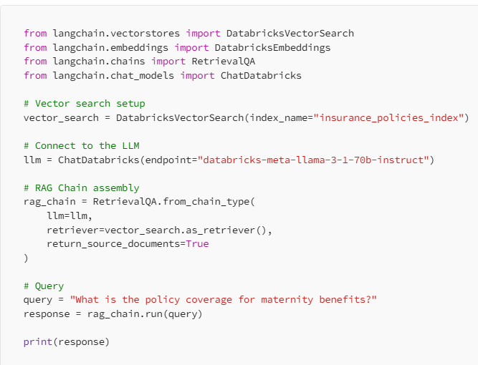
Code Walkthrough: Building a RAG System
Necessary libraries from LangChain and Databricks for embeddings, vector search, and chain assembly:
This initializes a vector search instance tied to a specific index in Databricks, enabling semantic document retrieval using MLflow-powered embeddings.
A connection is made to a language model hosted on Databricks, specifying the endpoint for transactions.
This combines the previously defined retriever (vector search) and the language model. The “RetrievalQA” chain ensures that queries are answered using both the model and the retrieved documents, with source documents returned for transparency.
A user query is processed by the RAG chain, retrieving relevant documents and generating a detailed answer using the language model. The response is printed at the end.

Slide 38
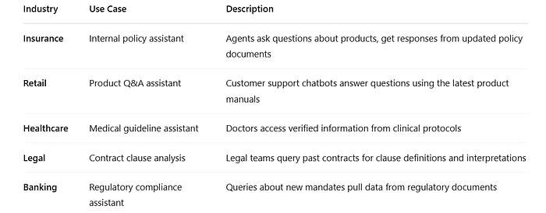
Enterprise Use Cases for RAG

Slide 39
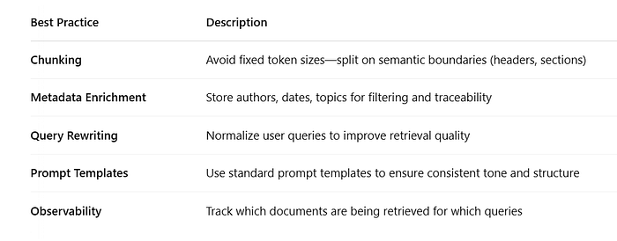
Best Practices in RAG systems

Slide 40
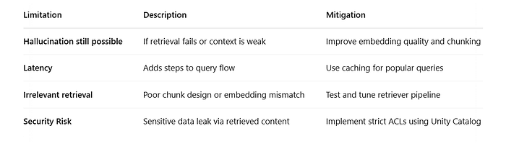
Governance and Compliance in RAG
When you build RAG systems on Databricks:
Use Unity Catalog to enforce access controls on sensitive source documents.
Store and manage prompts using a Prompt Repository.
Track model versions, prompt versions, and embeddings using MLflow.
Use audit logs to trace which documents were retrieved for any given answer.
Limitations of RAG (And Mitigations)

Slide 41
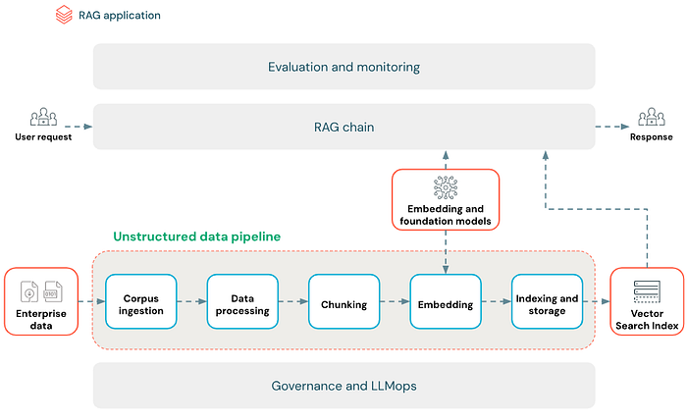
Preparing High-Quality Data for RAG Applications

Slide 42
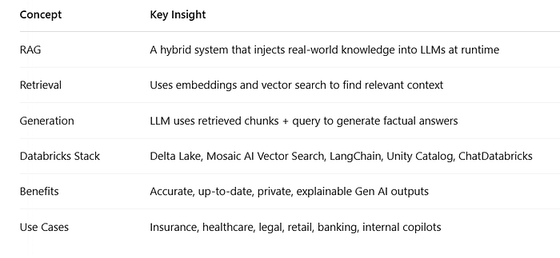
Summary – Part 1
RAG has quickly become the de facto design pattern for enterprise LLM applications.
It enables us to:
Ground your LLM on proprietary knowledge
Avoid costly model retraining
Minimize hallucinations
Provide explainable AI with document traceability

Slide 43
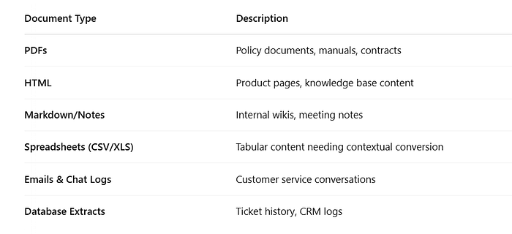
Source Document Types in RAG Pipelines
RAG pipelines typically work with unstructured or semi-structured enterprise content, such as:
A preprocessing pipeline is needed to extract clean, readable text from these formats.

Slide 44
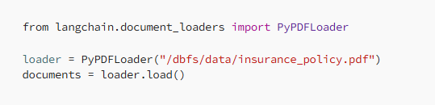
Text Extraction and Preprocessing PDF/Text Extraction Example:
Best Practices:
Normalize whitespace
Remove headers/footers and repetitive page numbers
Split multi-column documents into single column text
Convert scanned images using OCR (e.g., Tesseract)
For structured formats:
Convert rows to narrative sentences if needed for semantic retrieval.

Slide 45
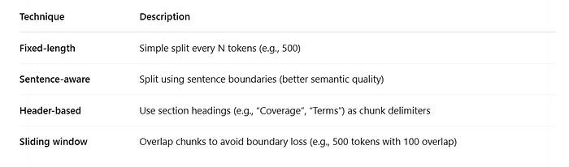
Chunking Strategies for Semantic Understanding
What is Chunking?
Chunking is the process of breaking down large documents into smaller, manageable semantic units that can be embedded and retrieved individually.
A good chunk is:
Self-contained
Topically consistent
Small enough to fit in an LLM prompt
Chunking Techniques:

Slide 46
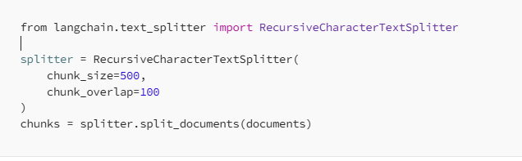
Example (LangChain):
Tip: Don’t make chunks too small. Too small = context fragmentation. Too large = LLM can’t process it.

Slide 47
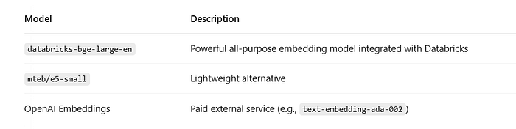
Embedding Generation — Vectorizing Your Chunks
Each chunk is converted into a vector using an embedding model.
What are Embeddings?
Embeddings are dense numerical representations of text in high-dimensional space, where semantically similar texts are geometrically close to each other.
Embedding Models to Use:

Slide 48
Embedding Generation — Vectorizing Your Chunks
Embedding in LangChain:
Code:
from langchain.embeddings import DatabricksEmbeddings embedding_model = DatabricksEmbeddings(model="databricks-bge-large-en") chunk_vectors = embedding_model.embed_documents([chunk.page_content for chunk in chunks])

Slide 49
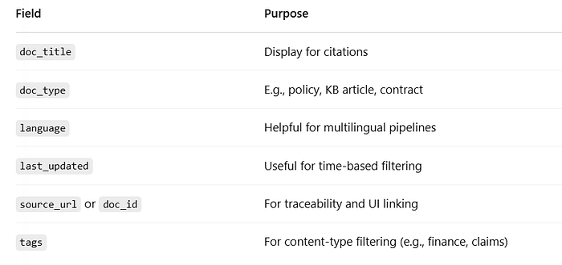
Metadata Design — Traceability, Filtering, Search
Metadata helps:
Filter documents based on user roles
Understand where the answer came from
Boost relevance using custom logic
Useful Metadata Fields:
Press enter or click to view image in full size

Slide 50
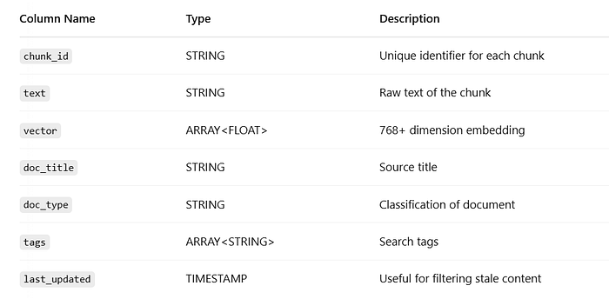
Delta Table Design for RAG
Delta Lake offers versioning, ACID compliance, and performance. This makes it ideal for storing RAG content.

Slide 51
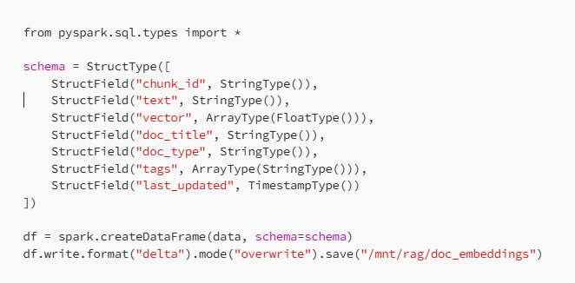

Sample Code to Create Delta Table:
Imports all data types from PySpark’s SQL module.
Defines a schema for the Delta table, specifying each field’s name and data type:
chunk_id, doc, doc_type, doc_path, embedding_model: strings for IDs, document contents, types, file paths, and model names.
vector: array of floats to store embedding vectors.
last_updated: timestamp indicating last update time.
Creates a Spark DataFrame using the above schema and some variable data.
Writes this DataFrame to a Delta table, overwriting any previous data at the given path.
Register it in Unity Catalog for governance, supporting data lineage, access control, and compliance:

Slide 52
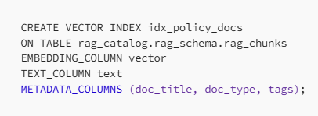
Vector Indexing Using Mosaic AI Vector Search
Once the Delta table is created, enable Mosaic AI Vector Search: Steps:
Ensure vector column exists and is float array
Enable Change Data Feed (CDF) for updates
Create an index:
We can now use:
LangChain to connect to the index
Semantic search to retrieve top-K relevant chunks
Audit the source using metadata in responses

Slide 53
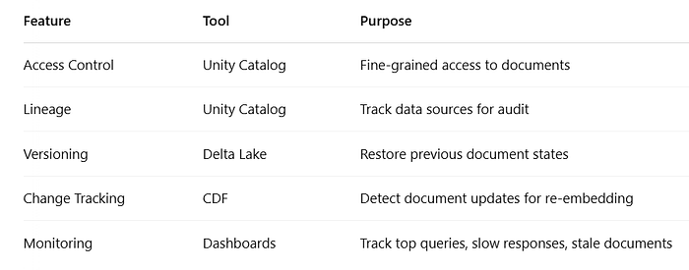
Governance and Observability
Data governance is critical for enterprise-grade RAG systems:

Slide 54
Section 2: Data Preparation (summary)
6. Apply a chunking strategy for a given document structure and model constraints
Applying a chunking strategy involves dividing documents into manageable pieces that fit within the model’s context window and constraints.
Key Considerations
Context Window
Chunking Strategy:
Context-aware Chunking: Divide text by sentences, paragraphs, or sections using special punctuation such as periods or newlines.
Fixed-size Chunking: Divide text into chunks of a specific number of tokens.
3. Advanced Chunking Strategies like Windowed Summarization where Each chunk includes a summary of the previous chunks to maintain context across the document.
7. Implementation Steps:
Data Extraction: Extract raw text from documents, ensuring it is clean and ready for processing.
Chunking Process: Apply the chosen chunking strategy (context-aware, fixed-size, windowed summarization)

Slide 55
.
Embedding and Storage: Embed each chunk using a model and store the embeddings in a vector store for efficient retrieval.
8. Challenges and Solutions:
Maintaining Context: Ensure that each chunk preserves enough context to be meaningful on its own.
Handling Different Document Types: Use appropriate tools and methods for different formats (e.g., .doc, .pdf, .dat, .html). Learn the basic python packages like doctr or pypdf
9. Use Case: Experiment with different chunk sizes and methods to find the best fit for the specific use case.
10. Filter extraneous content in source documents that degrades quality of a RAG application
This includes:
Cleaning Data: Ensuring the text is free from irrelevant content such as advertisements, navigation bars, and footers.
Preprocessing Steps: Applying preprocessing techniques like removing stop words, correcting misspellings, and normalizing text to enhance the quality of the data fed into the model

Slide 56
11. Choose the appropriate Python package to extract document content from provided source data and format
PyPDF, Hugging Face’s Options, Doctr — where OCR (Optical Character Recognition) is required to extract text; learn about bigger models: OpenAI’s Models, Alphabet’s Gemini 1.5, Meta’s Llamma
12. Define operations and sequence to write given chunked text into Delta Lake tables in Unity Catalog
Defining operations and sequence involves several steps:
Data Ingestion: Extract text content from documents and load it into a dataframe.
Chunking and Embedding: Apply chunking strategies and compute embeddings for each chunk.
Writing to Delta Lake: Store the chunked text and embeddings into Delta Lake tables. This process ensures the data is easily accessible for retrieval operations in Unity Catalog
Governance and Metadata Management: Ensure the tables are registered in Unity Catalog for proper governance and metadata management.

Slide 57
13. Continuous Integration and Data Refresh:
Automate Updates: Set up workflows to continuously update the Delta tables as new data arrives or existing data is modified.
Delta Live Tables: Use Delta Live Tables to automate and orchestrate these data workflows.
14. Identify needed source documents that provide the necessary knowledge and quality for a given RAG application
Relevance: Selecting documents that are highly relevant to the domain and task at hand.
Quality Assessment: Evaluating the accuracy, reliability, and completeness of the documents.
Diversity: Ensuring a diverse set of documents to cover various aspects of the knowledge required
15. Identify prompt/response pairs that align with a given model task
Identifying suitable prompt/response pairs involves:
Task Alignment: Ensuring the pairs are relevant to the specific task the model is designed to perform.
Contextual Relevance: Selecting pairs that provide sufficient context for the model to generate accurate responses.

Slide 58
Quality Control: Verifying that the prompt/response pairs are free from errors and biases
Tagging examples: For sentiment analysis, tag responses as positive, negative, or neutral. And for question-answering, tag responses as factual, opinion-based, or advisory
16. Use tools and metrics to evaluate retrieval performance
Context Precision: Measures how much of the retrieved context is actually relevant to the query.
Context Recall: Measures how much of the relevant context was successfully retrieved.
Faithfulness: Evaluates whether the generated answer accurately reflects the retrieved or source information.
Answer Relevancy: Assesses how directly the answer addresses the user’s query.
Answer Correctness: Judges whether the answer is factually and semantically accurate.
2. Evaluation Tools and Methods:
MLflow: Facilitates the evaluation of retrievers and LLMs, supporting batch comparisons and scalable experimentation. MLflow can evaluate unstructured outputs automatically and at low cost.
LLM-as-a-Judge: An approach where an LLM is used to evaluate the performance of another LLM by scoring responses based on predefined criteria. This method can be integrated with MLflow for automated and scalable evaluations.

Slide 59
Evaluation Tools and Methods:
MLflow: Facilitates the evaluation of retrievers and LLMs, supporting batch comparisons and scalable experimentation. MLflow can evaluate unstructured outputs automatically and at low cost.
LLM-as-a-Judge: An approach where an LLM is used to evaluate the performance of another LLM by scoring responses based on predefined criteria. This method can be integrated with MLflow for automated and scalable evaluations.
Task-specific Metrics: Metrics like BLEU for translation and ROUGE for summarization are used to evaluate LLM performance on specific tasks.

Slide 60
Offline vs. Online Evaluation:
Offline Evaluation: Conducted before deployment using curated benchmark datasets and task-specific metrics to evaluate LLM performance.
Online Evaluation: Conducted post-deployment, collecting real-time user behavior data to evaluate how well users respond to the LLM system. This approach includes metrics from A/B testing and user feedback.

Slide 61
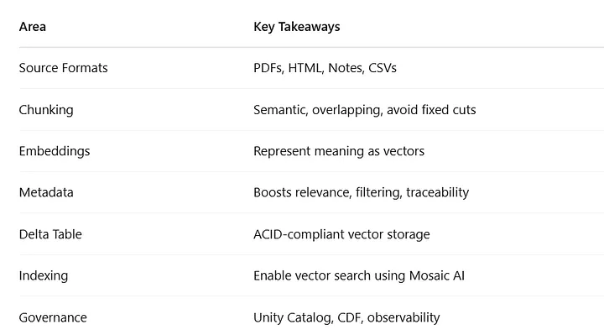
Summary – Part 2

Slide 62
Section 3: Application Development
EXL

Slide 63
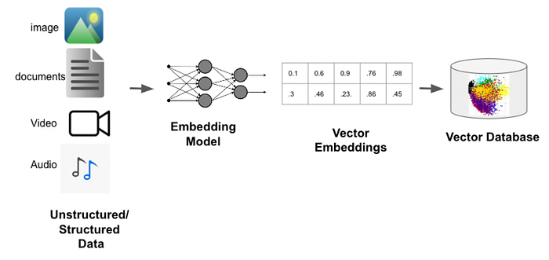
Embedding Models and Vectorization
What Are Embeddings?
An embedding is a vector representation of data — specifically, a way to map words, sentences, or documents to high-dimensional numerical space.

Slide 64
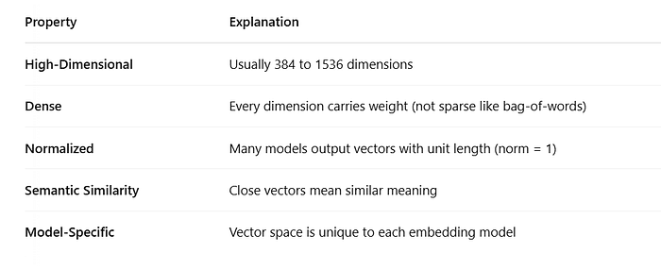
Example:
The phrase “health insurance coverage” might map to: [0.234, -0.111, 0.543, ..., 0.007] → 768-dim vector Similar phrases like “medical policy benefits” will have vectors close to it, while unrelated phrases will be far apart.
This geometric property allows you to:
Search by meaning, not exact words
Retrieve semantically relevant chunks
Connect unstructured text to structured queries
Key Properties of Embedding Vectors

Slide 65
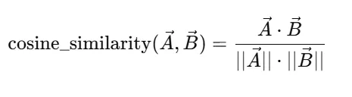
Cosine Similarity
Most RAG systems use cosine similarity to measure the closeness between a user query and document vectors:

Slide 66

Types of Embedding Models on Databricks
1. databricks-bge-large-en
The default embedding model used in Databricks
1024 dimensions, trained on multi-domain data
Great for semantic search, RAG, and classification tasks
Fine-tuned version of BAAI’s BGE series

Slide 67
Types of Embedding Models on Databricks
2. Open Source Models (Hugging Face)
E.g., sentence-transformers/all-MiniLM-L6-v2, mteb/e5-large
Can be hosted via Hugging Face on Databricks
Lighter, fast, but often lower performance in enterprise domains

Slide 68
Types of Embedding Models on Databricks
3. Proprietary Models (OpenAI)
E.g., text-embedding-ada-002
Used via external APIs
Higher cost and latency
May violate data residency or compliance policies

Slide 69
Types of Embedding Models on Databricks
4. Custom Fine-Tuned Models
Train on domain-specific corpora (e.g., legal clauses, financial disclosures)
Hosted in Model Registry or Model Serving on Databricks

Slide 70
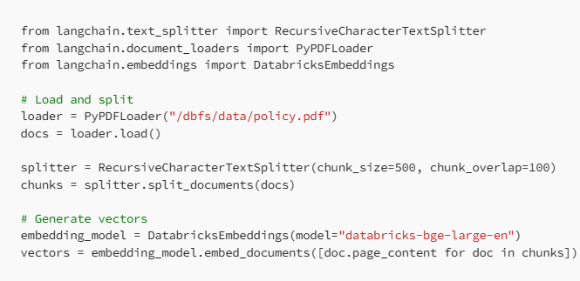
Vectorizing Data on Databricks
Step-by-Step Process
Extract Documents Use loaders (PDF, HTML, CSV, etc.)
2. Chunk Documents Semantic or recursive chunking (e.g., 500 tokens with 100 overlap)
3. Embed Chunks Generate embeddings for each chunk
4. Store Vectors in Delta Table Include raw text, metadata, and the embedding vector
5. Index with Mosaic AI Vector Search
LangChain Example:

Slide 71
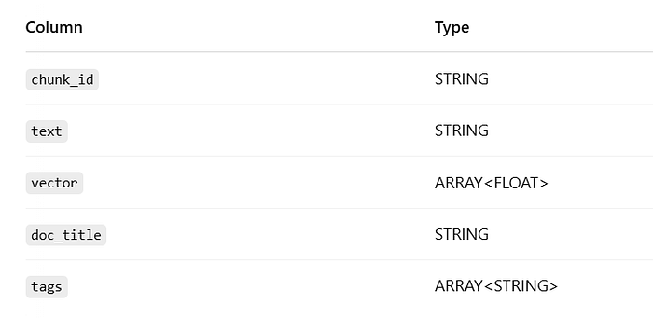

Storing Embeddings in Delta Lake
Each vector is a list of float values (length = model output dimensions).
Schema Example:

Slide 72
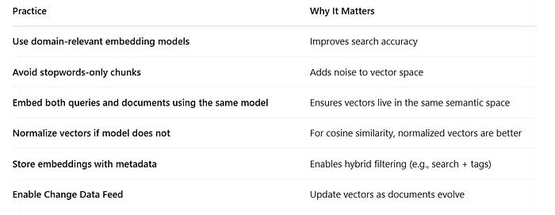
Best Practices for Embedding Pipelines

Slide 73
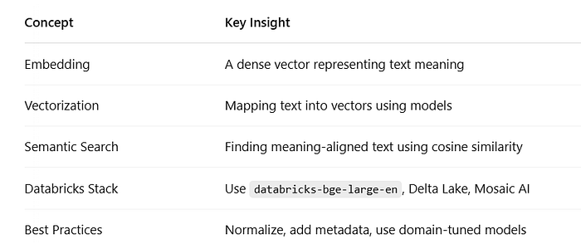
Evaluating Embedding Model Quality
1. Manual Testing
Input: Query
Output: Top-5 similar chunks
Expected: Chunks should answer query without LLM inference
2. Embedding Benchmarks
Use MTEB, BEIR, or internal Q&A datasets to compare models
3. LLM-Assisted Feedback Loop
RAG + LLM → Measure response quality.
Trace poor answers to bad retrieval → Fix embeddings

Slide 74
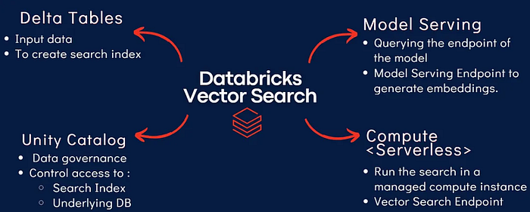
Databricks Vector Search Fundamentals

Slide 75
Databricks Vector Search Fundamentals
What Is Vector Search?
Vector search is a way to find information by meaning, not by exact terms.
A text chunk (e.g., a paragraph from a policy document) is turned into a vector — a list of floating-point numbers (e.g., 768 or 1024-dimensional).
A user’s query is also converted into a vector using the same model. The system then compares these vectors to find the most similar content using metrics like cosine similarity. This process is independent of specific keywords, allowing natural language queries to return more intelligent results.

Slide 76
How Does Vector Search Work in Databricks?
Mosaic AI Vector Search
Databricks provides Mosaic AI Vector Search, a first-party native engine designed to:
Index billions of vectors stored in Delta Lake
Enable fast, semantic top-K retrieval
Support hybrid queries with structured filters
Integrate seamlessly with LangChain and ChatDatabricks
Govern and track access using Unity Catalog
Support Change Data Feed for real-time updates

Slide 77
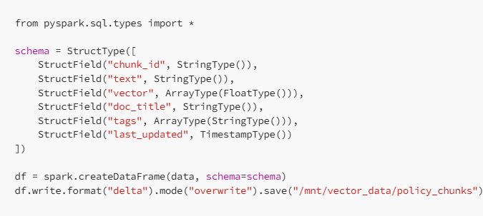
Step-by-Step: Creating a Vector Search Index
Step 1: Store Embeddings in a Delta Table

Slide 78


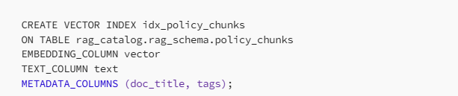
Step-by-Step: Creating a Vector Search Index
Step 2: Register Table in Unity Catalog
Step 3: Enable Change Data Feed
Step 4: Create Vector Index
Now your data is ready for semantic querying using SQL or APIs.
This will:
Embed the query, Search the vector index, Return the top 3 most semantically similar chunks

Slide 79
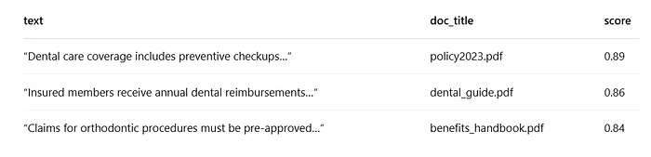
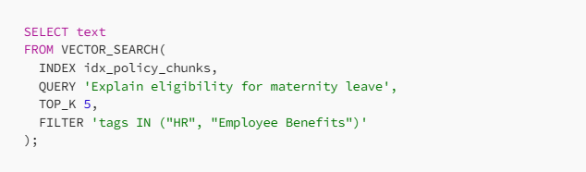
Sample Output:
You can add filters to constrain semantic results based on structured metadata.
This combines semantic similarity with enterprise control — a must for domain-specific use cases.

Slide 80
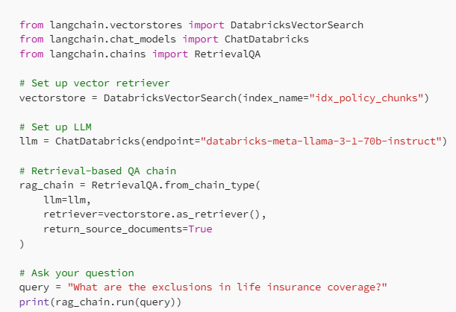
Integration with LangChain (Python)
LangChain makes it easy to plug Mosaic Vector Search into your GenAI pipeline.

Slide 81
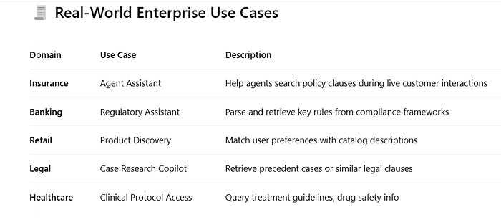
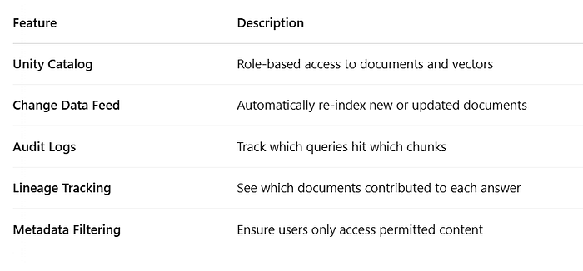
Governance, Observability & Auditability - Databricks brings enterprise trust to vector search:

Slide 82
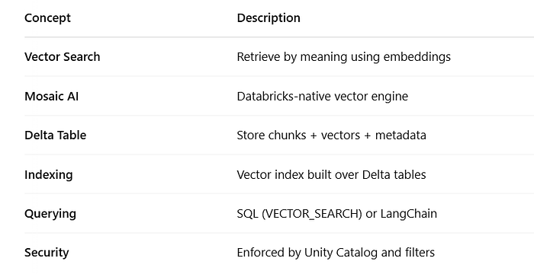
Summary

Slide 83
Section 3: Application Development
13. Create tools needed to extract data for a given data retrieval need
Key Points:
Data Extraction and Chunking: The process involves splitting documents into manageable chunks, embedding the chunks with a model, and storing them in a vector store.
Chunking Strategies: Use case-specific strategies include context-aware chunking by sentence or paragraph and fixed-size chunking by token count. Advanced strategies involve windowed summarization and metadata injection.
Challenges: Addressing complex documents, maintaining logical sections, and dealing with multi-modal data (text mixed with images).
Tools and Libraries: Tools like PyPDF for low-level extraction, and advanced models from Hugging Face and OpenAI for high-level contextual extraction.

Slide 84
14. Select Langchain/similar tools for use in a Generative AI application.
Key Points:
LangChain: A tool designed to manage interactions with language models, facilitating complex applications by linking together various components such as prompt templates, memory, and chains.
Vector Databases: Essential for storing high-dimensional vectors for efficient retrieval. Databricks supports integration with Mosaic AI Vector Search, which uses embedding models and vector search endpoints.
Integration with Databricks: The Databricks platform provides tools like Delta Live Tables and Unity Catalog for structured and unstructured data management, ensuring seamless integration with AI applications.
15. Identify how prompt formats can change model outputs and results
Key Points:
Prompt Engineering: The format and structure of prompts significantly impact the quality and accuracy of model outputs. Properly formatted prompts reduce hallucinations and improve response relevance.
Context Augmentation: Enhancing prompts with additional context from external sources (retrieved via vector databases) helps models generate more accurate and contextually relevant responses.
Impact of prompt formatting, including augmenting prompts with supplementary information to see better changes in detail and accuracy.

Slide 85
16. Qualitatively assess responses to identify common issues such as quality and safety
Key Points:
Evaluation Metrics: Use metrics like context precision, relevancy, recall, and answer correctness to assess the performance of RAG applications.
Quality and Safety: Identifying and addressing issues such as hallucinations, bias, and incomplete information is crucial. Techniques include constructing better prompts and using augmented context.
Continuous Learning and Feedback: Implementing a feedback loop in RAG systems allows for iterative improvements based on user interactions and system performance evaluation.
17. Select chunking strategy based on model & retrieval evaluation
Key Points:
Chunking Strategies: Choose between context-aware chunking (by sentence, paragraph, section) and fixed-size chunking (by tokens). Learn about the use case of each.
Impact on Retrieval: The chunking strategy affects the quality of retrieved context and model performance. Smaller chunks are useful for precision, whereas larger chunks capture broader themes.
Iterative Approach: Experiment with different chunk sizes and strategies. Evaluate based on the specific requirements of the application, considering the maximum context window of the LLM.

Slide 86
18. Augment a prompt with additional context from a user’s input based on key fields, terms, and intents
Key Points:
Prompt Augmentation: Enhance prompts by injecting relevant context retrieved from external sources like vector databases. This improves the relevance and accuracy of the generated responses.
Retrieval Augmented Generation (RAG): Use RAG to combine LLMs with external knowledge bases to provide more contextually accurate outputs.
Techniques: Use specific fields, terms, and user intents to tailor the additional context provided to the model, ensuring that the response is aligned with user needs.
19. Create a prompt that adjusts an LLM’s response from a baseline to a desired output
Key Points:
Prompt Engineering: Design prompts with clear instructions, context, and desired output format to guide the LLM towards generating the desired response. Include examples and use delimiters to structure the prompt effectively.
Iterative Development: Adjust parameters like temperature to fine-tune the creativity and focus of the responses. Iterative testing and refining of prompts help achieve the desired output quality.
Zero-shot and Few-shot Prompts: Utilize these techniques to provide the model with examples that help guide its responses, improving accuracy and relevance without extensive training data.

Slide 87
20. Implement LLM guardrails to prevent negative outcomes
Key Points:
Guardrails: Implement guardrails to prevent harmful or inappropriate responses. These can be simple (e.g., System Prompt — instructing the model not to provide certain information) or complex (e.g., using specialized models like Llama Guard).
Safety Filter on Foundation Model API (Instead of using System Prompts)
21. Write metaprompts that minimize hallucinations or leaking private data
Key Points:
Metaprompts Design: Focus on clear and precise instructions to minimize hallucinations. Include context that guides the LLM to provide accurate and relevant responses without fabricating information.
Guardrails Implementation: Utilize guardrails like Llama Guard to filter out sensitive or inappropriate content, ensuring responses do not leak private data.
Evaluation Techniques: Regularly evaluate the prompts and the responses to identify and rectify any hallucinations or data leakage issues.

Slide 88
22. Build agent prompt templates exposing available functions
Key Points:
Agent-Based Prompts: Design prompts for agents that expose and utilize specific functions or tools. These agents can dynamically interact with the environment and other tools to complete tasks.
Tools and Frameworks: Utilize tools like LangChain, AutoGPT, and OpenAI Function Calling to build robust agent-based systems. These frameworks provide a structure for defining and using functions within prompts.
23. Select the best LLM based on the attributes of the application to be developed
Key Points:
Model Attributes: Evaluate the attributes of various LLMs, such as their training data, fine-tuning capabilities, and performance metrics, to select the most suitable model for the application.
Task-Specific Models: Choose models that are specifically tuned or capable of performing the required tasks, whether it be text generation, summarization, or classification.
Benchmarking: Use benchmarks and performance evaluations to compare different models and select the one that offers the best trade-off between accuracy, efficiency, and cost.

Slide 89
24. Select an embedding model context length based on source documents, expected queries, and optimization strategy
Key Points:
Context Length Considerations: Select embedding models with appropriate context lengths to handle the expected length of source documents and queries. Ensure the chosen model can effectively capture and represent the necessary context and can take the chunk size.
Optimization Strategies: Balance between shorter and longer context lengths based on the specific needs of the application. Longer context lengths might capture more information but can be computationally expensive.
Embedding Model Selection: Use models that provide the best embeddings for both queries and documents, ensuring they operate within the context window limits and provide accurate results.
25. Select a model from a model hub or marketplace for a task based on model metadata/model cards
Key Points:
Model Metadata: Review model cards and metadata on Databricks Marketplace to understand the capabilities, limitations, and intended use cases of different models. This information is crucial for selecting the right model for the specific use of model — like “Is it open for public use?”.
Transparency and Accountability: Model cards provide transparency about the training data, performance metrics, and ethical considerations, aiding in making informed decisions about model selection.

Slide 90
26. Select the best model for a given task based on common metrics generated in experiments
Key Points:
Utilize common performance metrics; and also specific task-related metrics like BLEU or ROUGE for text tasks to evaluate models.
Experimentation and Benchmarking: Conduct experiments to generate performance data, comparing models based on these metrics to identify the best-performing model for the given task.
Iterative Improvement: Use the experimental results to iteratively improve model selection and fine-tuning, ensuring the chosen model consistently meets or exceeds performance expectations.

Slide 91
Integrating Vector Search into GenAI Pipelines
Why Integration Matters
Embedding data and creating a vector index is only part of the story. A complete GenAI pipeline is one where:
A user asks a natural language question
Relevant context is retrieved from vector search
The prompt is dynamically assembled
A large language model generates a grounded, contextual answer
The result is explainable, secure, and production-ready

Slide 92
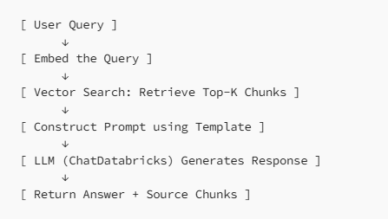
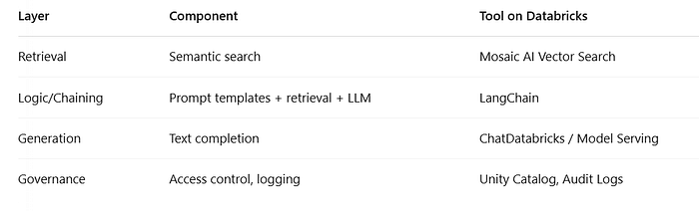
RAG Architecture Recap
Each layer has a specific function:

Slide 93
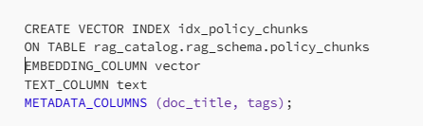



1. Vector Search Setup (Recap)
Assume we already have:
A Delta table with:
text, vector, doc_title, tags
An index created via:
2. Setting Up LangChain Components
Install requirements in Databricks (if not already available):
a) Load the Vector Index as a Retriever
b) Load the LLM from Databricks Serving

Slide 94
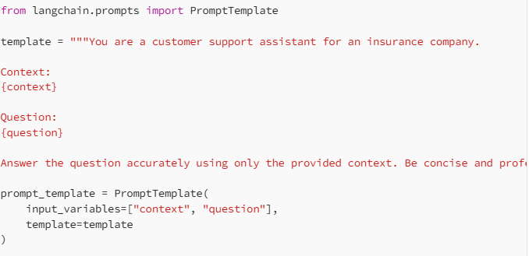
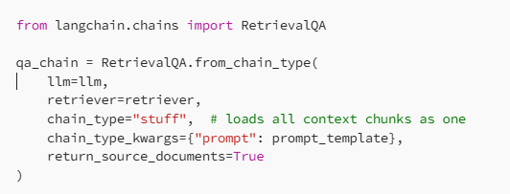
3. Designing the Prompt Template
Example Template:
Prompt templates help guide LLM behavior and structure.
A strong RAG prompt combines:
User question
Retrieved context
Instructions (e.g., tone, format)
4. Assembling the Chain
Use RetrievalQA to stitch together retrieval + prompt + LLM::
Creates an instance of RetrievalQA using the from_chain_type factory method. This lets you specify the type of retrieval and QA logic you want.
Parameter | Description
llm=llm | Language model for answering questions ​
retriever=retriever | Fetches relevant context documents ​
chain_type="stuff" | Loads all context as one chunk for LLM
chain_type_kwargs | Defines prompt used for LLM ​
return_source_documents | Returns answer + supporting source docs

Slide 95
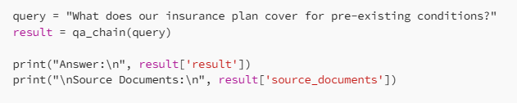
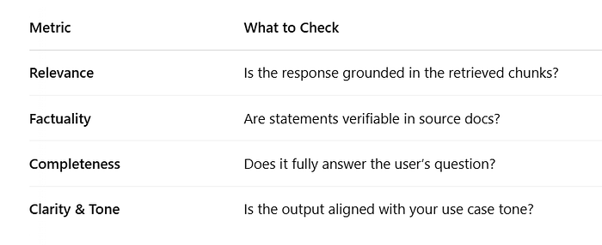
Run the pipeline:
5. Validating and Testing Your Pipeline - Functional Tests:

Slide 96
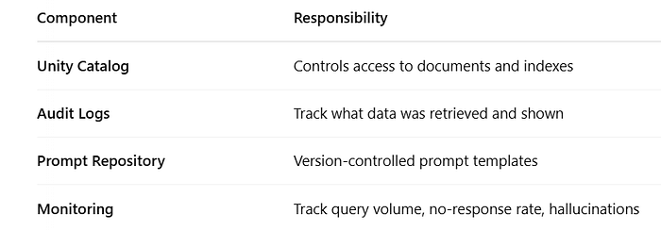
6. Real-World Use Case: Insurance Copilot
Scenario: You’re building a GenAI-powered assistant for customer service agents to answer complex policy questions.
Data: 300 insurance policy documents, chunked and indexed in vector search.
Goal: Answer queries such as:
“Does this policy cover maternity leave?”
“What is the waiting period for cancer treatment coverage?”
Solution:
Chunks are retrieved with Mosaic AI Vector Search
Prompt is crafted to ensure tone and factual constraints
Chat Databricks provides real-time answers within <2 seconds
Outcome: Reduced handling time by 35%, improved first-call resolution accuracy.
7. Governance and Observability

Slide 97

Summary

Slide 98
Section 4: Assembling and Deploying Applications
EXL

Slide 99

Section 4: Assembling and Deploying Applications
System Lifecycle:
Press enter or click to view image in full size
Band-wise Eligibility Duration (In hours) Date Start Time (IST) End Time (IST) Nomination Form
Band A and B 3 hrs. 11-Nov-25 3:00:00 PM 7:00:00 PM https://forms.office.com/r/GBfkWAG69p
Band A and B 3 hrs. 13-Nov-25 3:00:00 PM 7:00:00 PM

Slide 100
Key Points:
Pyfunc Model: MLflow’s pyfunc flavor is a versatile model interface for MLflow Python models. It allows models to be loaded as Python functions for deployment.
Pre- and Post-Processing: These are critical for preparing input data before it is fed into the model (pre-processing) and for handling the model’s output before it is presented to the end-user or downstream applications (post-processing). Techniques can include data normalization, feature extraction, and output formatting.
Implementation: Utilize the mlflow.pyfunc to log, save, and load models with necessary pre- and post-processing steps. This ensures the model can handle real-world data inputs and outputs effectively.

Slide 101
27. Code a chain using a pyfunc model with pre- and post-processing
Key Points:
Pyfunc Model: MLflow’s pyfunc flavor is a versatile model interface for MLflow Python models. It allows models to be loaded as Python functions for deployment.
Pre- and Post-Processing: These are critical for preparing input data before it is fed into the model (pre-processing) and for handling the model’s output before it is presented to the end-user or downstream applications (post-processing). Techniques can include data normalization, feature extraction, and output formatting.
Implementation: Utilize the mlflow.pyfunc to log, save, and load models with necessary pre- and post-processing steps. This ensures the model can handle real-world data inputs and outputs effectively.

Slide 102
28. Control access to resources from model serving endpoints
Key Points:
Access Control for endpoints
Databricks Features: Leverage Databricks’ built-in security features such as role-based access control (RBAC), Unity Catalog for data governance, and secure API endpoints to manage access to models and data securely.
Best Practices: Regularly review and update access permissions, monitor access logs for suspicious activities, and implement least privilege principles to minimize the risk of unauthorized access.
29. Code a simple chain according to requirements
Key Points:
Define the steps required for your application, configure each step with the necessary parameters and models, and use LangChain to manage the execution flow. Ensure that each step performs the required transformations and passes data correctly to the next step.
Chains: Chains are sequences of automated steps that process input data and generate output. They can be used to orchestrate complex workflows involving multiple models and data transformations.

Slide 103
LangChain: A popular framework for building chains in generative AI applications. It allows developers to define and link multiple steps, including data retrieval, transformation, and model inference, in a structured manner.
30. Code a simple chain using langchain
from langchain.chains import LLMChain from langchain.prompts import PromptTemplate from langchain.llms import OpenAI # Initialize the OpenAI LLM (Language Model) llm = OpenAI(openai_api_key="your_openai_api_key") # Define the prompt template prompt_template = PromptTemplate( input_variables=["input_text"], template="Summarize the following text: {input_text}" ) # Create the LLMChain llm_chain = LLMChain( llm=llm, prompt=prompt_template )

Slide 104
# Example input input_text = "Is it true? That LangChain is a framework for building applications powered by language models. It allows developers to create advanced chains of prompts, use different language models, and deploy them efficiently." # Run the chain with input output = llm_chain.run(input_text=input_text) # Display the output print("Summary:", output)
Key Points:
LangChain Framework: LangChain simplifies the creation of chains by providing a structured approach to link different components and steps in a generative AI pipeline.
Components: The main components of a LangChain chain include prompts, models, retrievers, and tools. Each component can be customized and combined to create complex workflows.
Example Workflow: A typical LangChain workflow might involve retrieving relevant documents using a retriever, processing the text with a language model, and post-processing the output to generate the final response. This structured approach ensures that each step is well-defined and can be easily modified or extended.

Slide 105
31. Choose the basic elements needed to create a RAG application: model flavor, embedding model, retriever, dependencies, input examples, model signature
Key Points:
Basic Elements: Key components of a Retrieval-Augmented Generation or RAG application like embedding model, retriever, vector store.
Model Flavor: Choose the appropriate model flavor based on the task. Common flavors include transformer models for text generation and embedding models for semantic search.
Dependencies and Model Signature: Ensure all dependencies are listed and included in the deployment environment. The model signature defines the input and output formats, ensuring compatibility with downstream applications.
32. Register the model to Unity Catalog using MLflow
Key Points:
Catalog.schema.model_name : Register and Load Models
from mlflow import MlflowClient # Define model name in the Model Registry model_name = f"{catalog_name}.{schema_name}.summarizer"

Slide 106
# Point to Unity-Catalog registry and log/push artifact mlflow.set_registry_uri("registry-uc") mlflow.register_model( model_uri=model_uri, name=model_name, )
# Sequence result — PANDAS
latest_model = mlflow.pyfunc.load_model( model_uri=f"models:/{model_name}/{current_model_version}" ) prod_data_sample_pdf = prod_data_df.limit(2).toPandas() summaries_sample = latest_model.predict(prod_data_sample_pdf["document"])
# Parallelize it for speed using SPARK_UDF
prod_model_udf = mlflow.pyfunc.spark_udf( spark, model_uri=f"models:/{model_name}@champion", env_manager="local", result_type="string", )

Slide 107
batch_inference_results_df = prod_data_df.withColumn("generated_summary", prod_model_udf("document"))
If a multi-node cluster, spark will send document partitions to corresponding many nodes.
# Materialize the batch as soon it’s done
batch_inference_results_df.write.mode("append").saveAsTable("TABLE_NAME")
MLflow Integration: MLflow’s Model Registry, integrated with Unity Catalog, offers a centralized model store for managing the lifecycle of machine learning models. It supports versioning, staging, and deploying models while maintaining full lineage and metadata tracking.
Model Registration Process: To register a model, log the model using mlflow.log_model() and then register it to Unity Catalog. This process ensures that all versions of the model are tracked and can be managed via the MLflow UI or API.
Security and Access Control using Unity Catalog
33. Sequence the steps needed to deploy an endpoint for a basic RAG application
Key Points:
RAG Application Components: A typical RAG application involves setting up a retriever, an embedding model, a vector store, and a generator. Each component plays a crucial role in the end-to-end workflow
Learn about the overall RAG Deployment Steps on Databricks including Retrieval Component, Embedding Model, Vector Search Index, Foundation Model, Create and Deploy Model Serving Endpoint for real-time querying.

Slide 108
34. Create and query a Vector Search index
Key Points:
Vector Search Setup: Create a vector search index by syncing it with a Delta table that stores embeddings. This index allows for real-time approximate nearest neighbor searches.
Use the provided REST API or Python SDK to query the vector search index. Queries can be made using vector representations to find similar documents or data points.
Mosaic AI Vector Search supports automatic syncing, self-managed embeddings, and CRUD operations. It integrates with Unity Catalog for governance and access control.
35. Identify how to serve an LLM application that leverages Foundation Model APIs
Key Points:
Foundation Model APIs: Foundation models like OpenAI’s GPT are served via Databricks Model Serving. These APIs provide a standardized way to deploy and query large language models without much effort by user.
Serving Process: Model Deployment, Query Handling, Integration with MLflow and Resource Management to ensure that appropriate compute resources (CPU/GPU) are allocated for serving the models, and use Databricks’ auto-scaling features to handle variable loads efficiently.

Slide 109
36. Identify resources needed to serve features for a RAG application
Key Points:
Compute Resources: Like above. Use Databricks’ scalable compute options to allocate necessary CPU/GPU resources based on the application load and performance requirements.
Storage and Indexing: Utilize Delta tables for storing raw and processed text, embeddings, and vector indexes. Ensure these are properly managed and synced for efficient retrieval.
Monitoring and Logging: Implement inference logging to track model performance and diagnose issues.

Slide 110

Assembling a RAG Application on Databricks LangChain + ChatDatabricks + Mosaic Vector Search = A Production-Ready RAG Pipeline
Pinecone is a fully managed vector database designed to efficiently store, index, and search high-dimensional vector embeddings produced by AI models, such as those from text, images, or user data.
This is ideal for use cases like semantic search, recommendation systems, and similarity matching—tasks where traditional databases are slow or inefficient due to the complexity and scale of vector data.
LangChain for orchestration
Mosaic AI Vector Search for retrieval
ChatDatabricks for response generation

Slide 111
Assembling a RAG Application on Databricks
How Pinecone Works
Storing Embeddings: Pinecone stores numerical vectors (embeddings) that capture semantic information from data such as documents or user profiles.​
Similarity Search: When a query is made, Pinecone computes its embedding and finds the most similar vectors by searching through the stored database using efficient similarity measures (e.g., cosine similarity).​
Real-Time and Scalable: Pinecone offers millisecond-level response times even for millions to billions of vectors, making it suitable for real-time applications.​
Key Features
Fully managed and serverless, so users do not manage infrastructure.​
Scales horizontally to handle large, high-dimensional datasets.​
Fast, low-latency vector similarity search.​
Real-time data ingestion and processing, always reflecting the latest inserted or updated data.​
Integration with cloud, ML, and data platforms for easy application development.​
Use Cases
Retrieval-augmented generation (RAG) for AI chatbots and assistants.
Semantic search where meaning/context matters more than keywords.
Product, content, and user recommendation systems.
Any ML workflow needing complex similarity matching in large datasets.

Slide 112

RAG Architecture Recap (Production View)

Slide 113



Application Structure
Create the Retriever (Mosaic AI Vector Search)
Connect to the LLM (ChatDatabricks)
Design a Structured Prompt Template
Assemble the RAG Chain

Slide 114

Summary

Slide 115
Section 5: Governance
EXL

Slide 116

37. Use masking techniques as guard rails to meet a performance objective
Key Points:
Masking Techniques: Examples include tokenization, anonymization, and pseudonymization.
Implementation: Masking can be applied at various stages of data handling, such as input processing, data storage, and during model inference to prevent leakage of private data.
Balance is crucial for meeting both compliance and performance objectives.

Slide 117
Key Workflow Flows
Data flows from "Raw Data" (1) → "Data Prep" (2) → "Datasets" (3).
Features/models are catalogued (4) and referenced for model building (5, 6, 7).
Trained models and their assets are managed (8), then deployed (9) for serving inference requests.
Monitoring (10) ensures logging and operational stability.
The entire system is under the oversight of "Governance," spanning DataOps, ModelOps, and DevSecOps disciplines.

Slide 118
38. Select guardrail techniques to protect against malicious user inputs to a GenAI application
Key Points:
Guardrail Techniques: Input validation, context-aware filtering, prompt sanitization to protect against harmful or malicious inputs. Implementing these helps in preventing prompt injection attacks and inappropriate content generation.
Learn about Llama Guard LLM which is in Databricks Marketplace
Continuous testing and updating of guardrails are essential to adapt to new types of malicious inputs and ensure the system’s integrity and security.
39. Recommend an alternative for problematic text mitigation in a data source feeding a RAG application
Key Points:
Addressing issues such as bias, misinformation, or inappropriate content in data sources used
Data Cleansing: Techniques include preprocessing steps like text normalization, filtering out offensive terms, and leveraging domain-specific stop words lists to cleanse the data before it is fed into the model.
External Data Sources: Using reputable and well-moderated external data sources to augment prompts can help mitigate the inclusion of problematic text, ensuring the generation of more accurate and safe responses.

Slide 119
40. Use legal/licensing requirements for data sources to avoid legal risk
Key Points:
Legal Compliance: Understanding and adhering to the legal and licensing requirements of data sources is crucial to avoid legal risks. This involves reviewing licenses and ensuring that the use of data complies with the terms specified.
Dataset Licensing: Evaluate the licensing information of datasets available in various platforms including Databricks Marketplace, consulting with legal teams to ensure that the intended usage is permitted.
Regular Audits: Conducting regular audits of data usage and maintaining detailed records of data sources and their licenses can help in managing legal risks effectively.

Slide 120
Section 6: Evaluation and Monitoring
EXL

Slide 121

RAG Evaluation

Slide 122

What Are We Evaluating?
A RAG application has two critical sub-systems to evaluate:

Slide 123


Core Evaluation Metrics
A. Retrieval Evaluation
B. Generation Evaluation

Slide 124
Quantitative Evaluation Metrics
A. Using Synthetic Q&A Pairs
Create a dataset of known:
Questions
Expected answers
Relevant document chunks
Then test the system for:
Retrieval accuracy (was the expected document returned?)
Answer correctness (was the final output within expectations?)
This enables automated evaluation without needing human labels every time.
B. Embedding Similarity Check
Use cosine similarity between:
The query vector and the top-k chunk vectors
The response and the retrieved chunks

Slide 125

Quantitative Evaluation Metrics
C. Automated LLM Grading
Use an LLM like ChatDatabricks to grade another LLM’s response:
4. Human-in-the-Loop Evaluation
Human evaluation is slow but essential for:
New domains
Regulated answers
Edge-case queries
Techniques:

Slide 126

Human-in-the-Loop Evaluation
Human evaluation is slow but essential for:
New domains
Regulated answers
Edge-case queries
Techniques:

Slide 127
Building an Evaluation Pipeline on Databricks
Step-by-Step:
Log each RAG response in a Delta
Table: query, llm_response, retrieved_chunks, timestamp, prompt_version
Add synthetic ground truth for internal tests:
Store as expected_answer, expected_chunks
Compute metrics using PySpark:
Similarity, Recall@K, BLEU/ROUGE scores (optional)
Visualize metrics using Databricks SQL or dashboards:
Top failed queries, drift over time
Flag outliers for manual review:
Low-confidence responses → push to review UI

Slide 128

Building an Evaluation Pipeline on Databricks
Sample Evaluation Table Schema (Delta)

Slide 129
41. Select an LLM choice (size and architecture) based on a set of quantitative evaluation metrics
Key Points:
Learn about various Quantitative Evaluation Metrics like Context Precision, Context Recall, Faithfulness, Answer Relevancy, Answer Correctness
Model Size and Architecture: Evaluate the trade-offs between model size and architecture (e.g., smaller models for faster inference and lower costs vs. larger models for higher accuracy)
Performance vs. Cost: Consider the computational resources required and the cost implications of deploying large models, especially in real-time applications VS Batch based LLM applications
LLMs as a Judge: Best practices for using an LLM to evaluate another LLM:
Use Small Rubric Scales: Prefer scales like 1–3 or 1–5.
Provide Examples: Include diverse examples with detailed justifications for each score.
Use Additive Scales: Break evaluation into parts with additive scoring (e.g., 1 point for X, 1 for Y, 0 for Z = 2 points).
Use High-Token LLMs: More tokens allow for richer context in evaluations.
Offline VS Online Evaluation — User response on LLM output; Detect Drifts; Learn about new Databricks Solutions.

Slide 130
42. Select key metrics to monitor for a specific LLM deployment scenario
Key Points:
Monitoring Metrics: Key metrics include latency, throughput, accuracy, and resource utilization. For LLMs, additional metrics like context precision, relevancy, and faithfulness are important to ensure the quality of generated responses.
Real-time Monitoring: Implement continuous monitoring of model performance using tools — MLflow to log and visualize these metrics, enabling proactive issue diagnosis and performance tuning.
Monitoring Solutions: Like Alerts for automated emails and insights, metric calculations, and dashboard to maintain optimal performance and cost-efficiency.
43. Evaluate model performance in a RAG application using MLflow
Key Points:
MLflow for RAG Evaluation: MLflow supports the evaluation of RAG applications by tracking and comparing performance metrics across different model versions and configurations. MLflow to log parameters, metrics, and artifacts

Slide 131

44. Use inference logging to assess deployed RAG application performance
Key Points:
Inference Table Logging: Capture detailed logs of inference requests and responses to analyze model behavior and performance in production. This includes logging input queries, retrieved contexts, and generated outputs.
Data Utilization: Use logged data to compute key metrics such as latency, accuracy, and relevance, and to identify patterns or anomalies that may indicate issues with the deployed model.
Log in inference tables to visualize performance trends and set up alerts for key metrics, ensuring continuous performance optimization. Automatic Logging — PII, Input expectation and rules.

Slide 132

Monitoring( 3 types):
Time series: It computes data quality metrics across time-based windows of the time series.
InferenceLog: This monitor is used for tables that contain the request log for a model. Each row in the table represents a request, with columns for the timestamp, the model inputs, the corresponding prediction, and optionally the ground-truth label. The monitor compares model performance and data quality metrics across time-based windows of the request log.
Snapshot: This type is used for all other types of tables. Monitoring calculates data quality metrics over all the data in the table, and the entire table is processed with every refresh.
Turn on Monitoring using:
Quality tab on UC Tables
Code:
2. Code

Slide 133
45. Use Databricks features to control LLM costs for RAG applications
Cost Control Strategies: model sizes; efficient data retrieval strategies — vector library like FAISS vs vector stores; batch processing for non-real-time tasks.
Track resource usage
Resource Management: Utilize features like auto-scaling and resource tagging to manage and optimize resource allocation dynamically

Slide 134

Summary

Slide 135
Thank you
EXL

